Slide 1

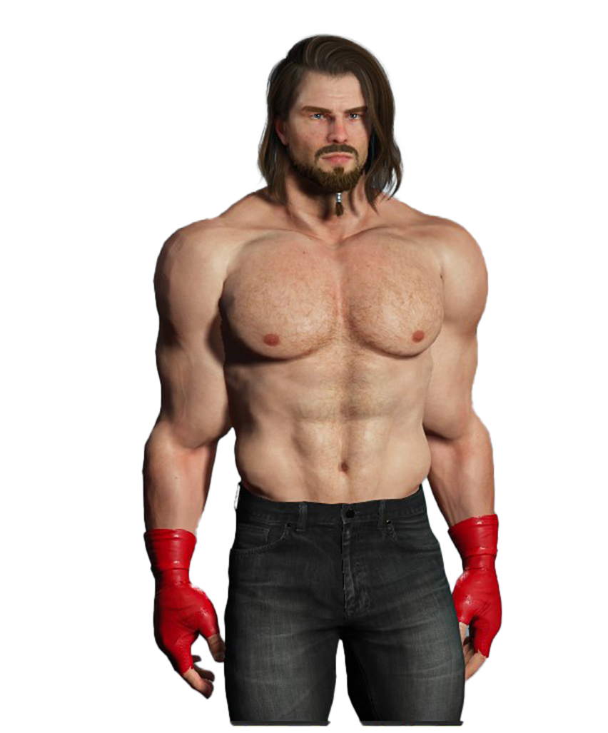



RAY
NERO
VS

Slide 2
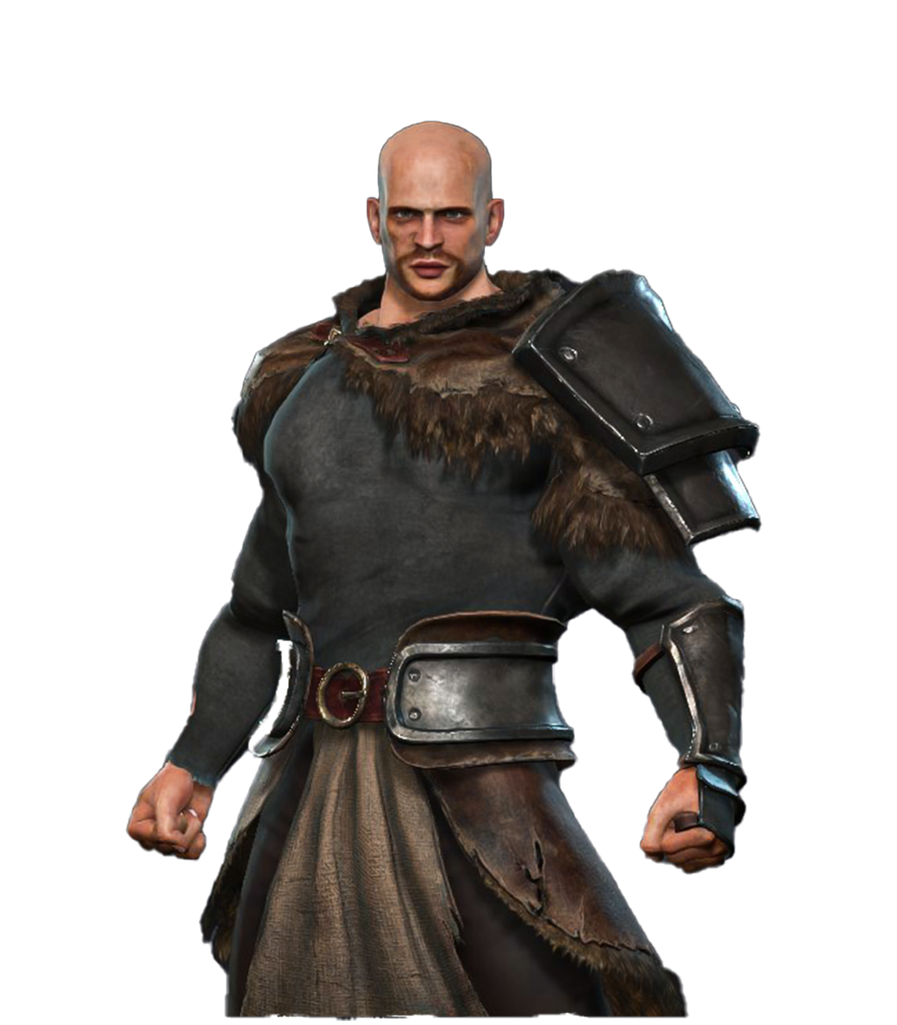
RAY
KEN
VS

Slide 3

RAY
VERGIL
VS

Slide 4

RAY
V
VS

Slide 5
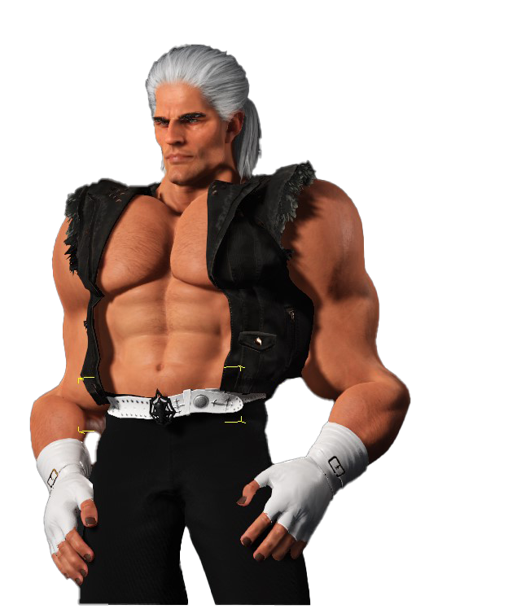
RAY
SHEEN
VS

